Slide 1

JavaScript
Sudhakar E
OptumRx SSS Team
Email : Sudhakar_enikapally@optum.com

Slide 2
JavaScript is a lightweight, interpreted programming language with object-oriented capabilities that allows you to build interactivity into otherwise static HTML pages.
JavaScript is:
JavaScript is a lightweight, interpreted programming language
Designed for creating network-centric applications
Complementary to and integrated with Java
Complementary to and integrated with HTML
Open and cross-platform

Slide 3
Advantages of JavaScript
Less server interaction
Immediate feedback to the visitors
Increased interactivity
Richer interfaces
Limitations with JavaScript
Client-side JavaScript does not allow the reading or writing of files. This has been kept for security reason.
JavaScript can not be used for Networking applications because there is no such support available.
JavaScript doesn't have any multithreading or multiprocess capabilities.

Slide 4
Syntax
A JavaScript consists of JavaScript statements that are placed within the <script>... </script> HTML tags in a web page.
<script>
//script code
</script>
The script tag takes two important attributes:
language: This attribute specifies what scripting language you are using. Typically, its value will be javascript. Although recent versions of HTML (and XHTML, its successor) have phased out the use of this attribute.
type: This attribute is what is now recommended to indicate the scripting language in use and its value should be set to "text/javascript".

Slide 5
<html>
<body>
<script language="javascript" type="text/javascript">
<!--
document.write("Hello World!")
//-->
</script>
</body>
</html>
Note : we call a function document.write which writes a string into our HTML document. This function can be used to write text, HTML, or both.
Whitespace and Line Breaks
Semicolons are Optional
Case Sensitivity

Slide 6
Script in <head>...</head> section.
Script in <body>...</body> section.
Script in <body>...</body> and <head>...</head> sections.
Script in and external file and then include in <head>...</head> section.
If you want to have a script run on some event, such as when a user clicks somewhere, then you will place that script in the head
If you need a script to run as the page loads so that the script generates content in the page, the script goes in the <body> portion of the document

Slide 7
Variables
JavaScript allows you to work with three primitive data types:
Numbers eg. 123, 120.50 etc.
Strings of text e.g. "This text string" etc.
Boolean e.g. true or false.
JavaScript Variable Scope:
The scope of a variable is the region of your program in which it is defined. JavaScript variable will have only two scopes.
Global Variables: A global variable has global scope which means it is defined everywhere in your JavaScript code.
Local Variables: A local variable will be visible only within a function where it is defined. Function parameters are always local to that function.

Slide 8
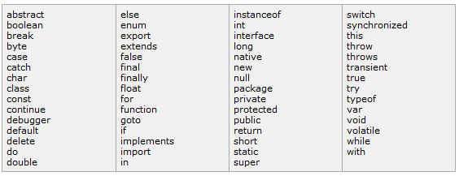
JavaScript Reserved Words

Slide 9
if statement:
if (expression){
Statement(s) to be executed if expression is true
}
else{
Statement(s) to be executed if expression is false
}
switch statement:
switch (expression)
{
case condition 1: statement(s)
break;
case condition 2: statement(s)
break;
case condition n: statement(s)
break;
default: statement(s)
}

Slide 10
While loop:
while (expression){
Statement(s) to be executed if expression is true
}
For loop:
for (initialization; test condition; iteration statement){
Statement(s) to be executed if test condition is true
}
For in loop:
for (variablename in object){
statement or block to execute
}

Slide 11
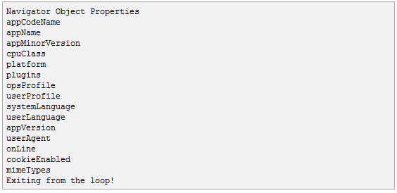
<script type="text/javascript">
var aProperty;
document.write("Navigator Object Properties<br /> ");
for (aProperty in navigator)
{
document.write(aProperty);
document.write("<br />");
}
document.write("Exiting from the loop!");
</script>

Slide 12
Functions :
A function is a group of reusable code which can be called anywhere in your programme. This eliminates the need of writing same code again and again. This will help programmers to write modular code. You can divide your big programme in a number of small and manageable functions.
What is an Event ?
JavaScript's interaction with HTML is handled through events that occur when the user or browser manipulates a page.
When the page loads, that is an event. When the user clicks a button, that click, too, is an event. Another example of events are like pressing any key, closing window, resizing window etc.

Slide 13
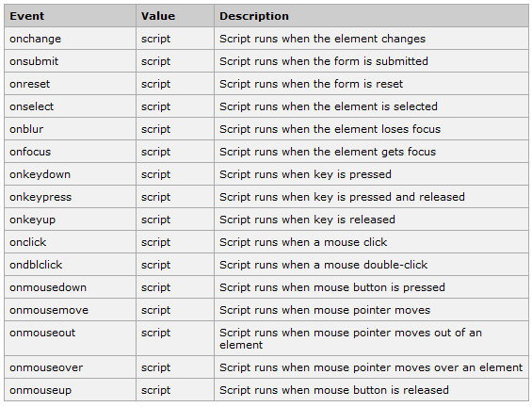

Slide 14
What are Cookies ?
Web Browser and Server use HTTP protocol to communicate and HTTP is a stateless protocol. But for a commercial website it is required to maintain session information among different pages. For example one user registration ends after completing many pages. But how to maintain user's session information across all the web pages.
In many situations, using cookies is the most efficient method of remembering and tracking preferences, purchases, commissions, and other information required for better visitor experience or site statistics.
Syntax :
document.cookie = "key1=value1;key2=value2;expires=date“;

Slide 15
How It Works ?
Your server sends some data to the visitor's browser in the form of a cookie. The browser may accept the cookie. If it does, it is stored as a plain text record on the visitor's hard drive. Now, when the visitor arrives at another page on your site, the browser sends the same cookie to the server for retrieval. Once retrieved, your server knows/remembers what was stored earlier.
Cookies are a plain text data record of 5 variable-length fields:
Expires : The date the cookie will expire. If this is blank, the cookie will expire when the visitor quits the browser.
Domain : The domain name of your site.
Path : The path to the directory or web page that set the cookie. This may be blank if you want to retrieve the cookie from any directory or page.
Secure : If this field contains the word "secure" then the cookie may only be retrieved with a secure server. If this field is blank, no such restriction exists.
Name=Value : Cookies are set and retrieved in the form of key and value pairs.

Slide 16
Example :
<html>
<head>
<script type="text/javascript">
function WriteCookie()
{
if( document.myform.customer.value == "" ){
alert("Enter some value!");
return;
}
cookievalue= escape(document.myform.customer.value) + ";";
document.cookie="name=" + cookievalue;
alert("Setting Cookies : " + "name=" + cookievalue );
}
</script>
</head>
<body>
<form name="myform" action="">
Enter name: <input type="text" name="customer"/>
<input type="button" value="Set Cookie" onclick="WriteCookie();"/>
</form>
</body>
</html>

